Slide 1


Effective Unit Testing
Wayne Schroder
Sample code/demos available at:
https://github.com/wschroder/UnitTestingDemo.GitHub
Notes:
If you’re watching this, I already know a few things about you:
Since you work at AgileThought, odds are pretty good that you already do unit testing and know the basics.
As with many developers, you’ve probably felt some measure of frustration with unit tests
You care about your art, and want to know best practices

Slide 2

30 years development
Live in Atlanta with my wife, Gana.
5 grown kids (blended family)
Reading, learning, fitness and camping
Mostly Microsoft, .Net
Code for Atlanta
Software design & architecture, Cloud-native development

Slide 3

Agenda
Arrange / Act / Assert
Isolation
Code Coverage
TDD Cycle: Red-Green-Refactor
Behavior Focused Testing
Add structure with “TestHelper” Pattern
Pitfalls (Testing the wrong things)
Configuration
Dependencies
Environment
Implementation

Slide 4
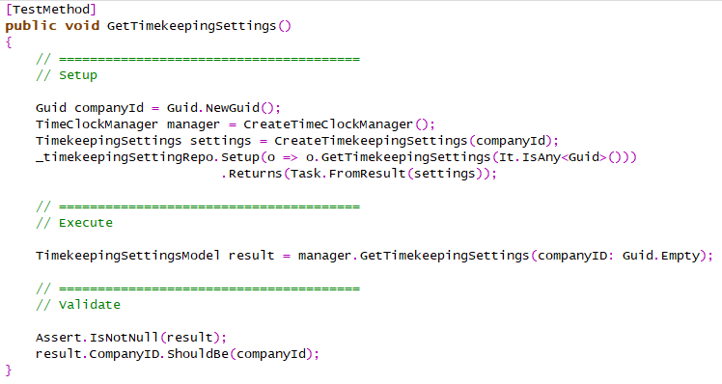
Arrange
Act
Assert

Slide 5

Test Scope
Demo
SUT
Scenario A
Operation 1
Scenario B
private method 1
Scenario C
private method 2
Scenario A
Operation 2
Scenario B
private method 3
private method 4
Notes:
Guidelines
SUT (“Subject Under Test”) is the test class
One test class per SUT and one SUT per test class
Identify the public operations (public methods)
Identify scenarios
One test per (operation x scenario)

Slide 6

Test “Mocks”
Demo
Isolation (drives good design)
Setting state / preconditions
External dependencies
Verifying calls made / Not made
Callbacks
More control over mock behavior at runtime
Caching of parameters for later evaluation

Slide 7

Focus on Responsibilities
Demo
Expected responses & changes to environment
Brittle Tests – Tests based on unimportant implementation details
Short-circuited tests

Slide 8
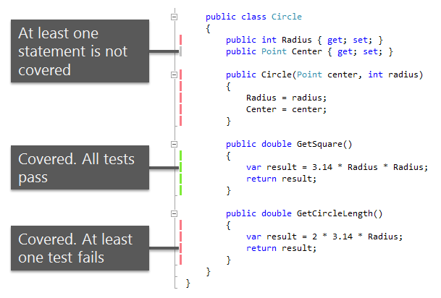
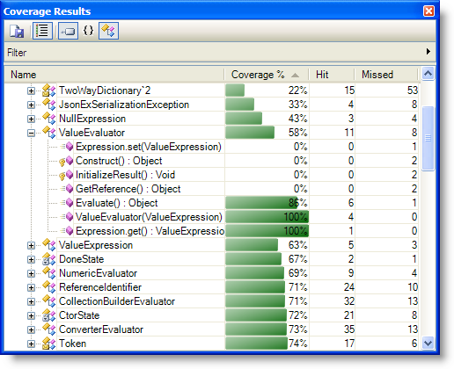
Code Coverage

Slide 9

Pitfalls
Demo
Complex test setup
Short-circuit tests
What NOT to Test:
Configuration
Dependencies
Environment
Implementation

Slide 10

Broken Tests
“All Green” as a Safety Net
Options when tests broken:
Fix broken tests now
Mark broken tests as "Ignore"
Leave them broken

Slide 11
Test Driven Development (TDD)
Demo
Start
Test
Code
Test
Refactor
Finish
Notes:
Trains you to focus on class/method responsibility

Slide 12
“TestHelper” Pattern
Demo
Goal: Make complex tests easier to understand & maintain
Add structure by splitting out a test-helper class
Home for more complex test logic
Makes your tests clean & simple, focused on high level test logic
Separates out clutter like object creation, test setup, test verification steps
For complex setups, extend with Builder Pattern

Slide 13
Integration Tests
Web service / API
Database
Keep in separate projects
Manual Testing
Integration Testing
Unit Testing
more integration
slower
more isolation
faster
https://martinfowler.com/articles/practical-test-pyramid.html

Slide 14

Database Integration Tests
Needed when logic stored in DB (sprocs, etc)
Requires tight version synchronization
Cleanup strategy (PRE or POST test)
Use fixed value for common attribute
Keep list of references to created data
Risks
Assumptions about data or schema version
Concurrent testing against shared database
Users at different versions

Slide 15
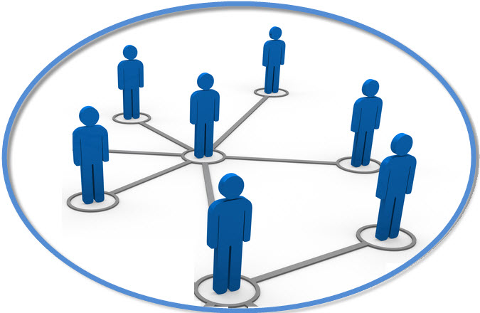
Web Integration Tests
Requires explicit setup
Greater risk over data dependency
This Photo by Unknown Author is licensed under CC BY-NC

Slide 16
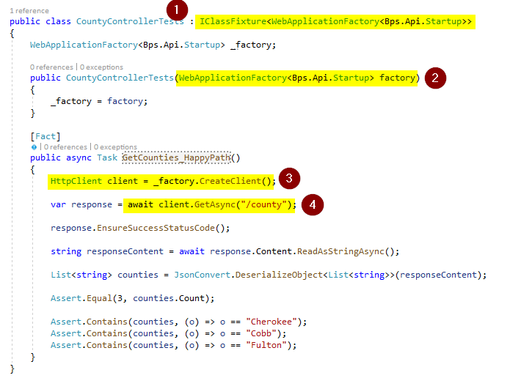
API Controller Tests (self hosted)
See: Microsoft.AspNetCore.Mvc.Testing

Slide 17

Main Points to Remember
Keep tests short, sweet & visible.
Focus on testing behaviors / responsibilities
Isolate your test subject.
Use structure to keep tests easy to read/maintain.
“All Green” policy / Protect the safety net
Keep Unit Tests and Integration Tests separate

